Slide 1
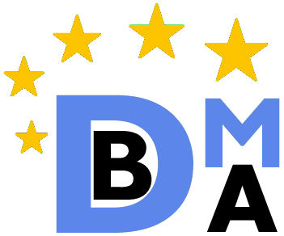
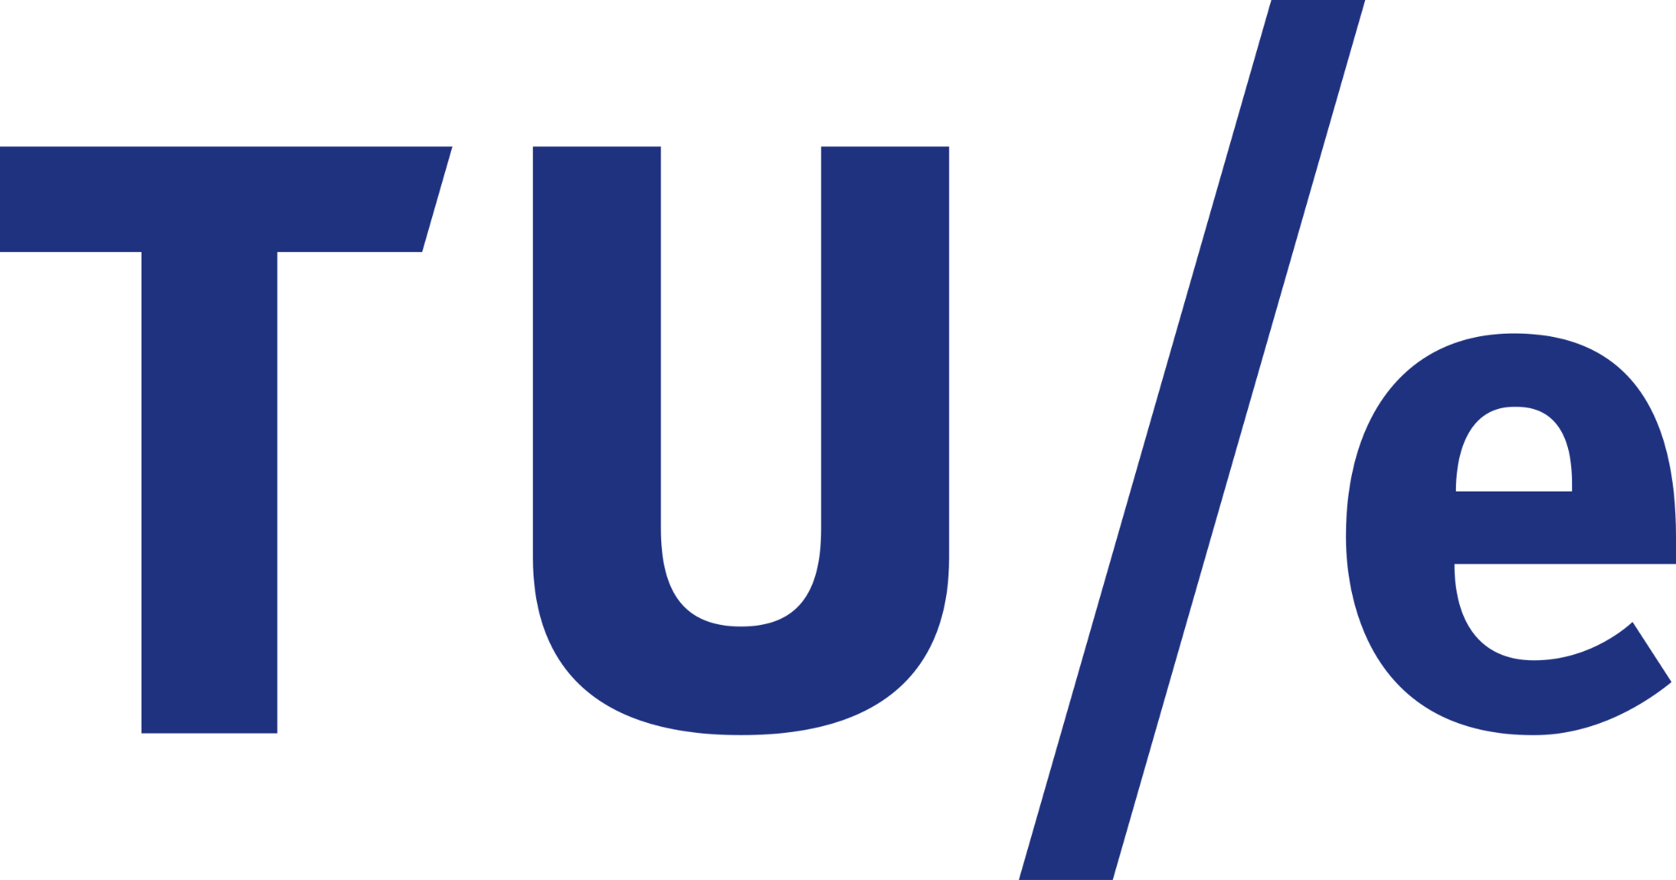
Erasmus Mundus Joint Master Degree Program in Big Data Management and Analytics (BDMA)
Master’s Thesis
Actor-Critic Reinforcement Learning
Models for Portfolio Management
Student: Hieu Nguyen Minh Supervisor: Prof. Mariangela Guidolin
Eindhoven, 11/09/2025
🇧🇪 🇪🇸 🇫🇷 🇮🇹 🇳🇱

Slide 2
Contents
Motivation
Background
Models
Experiments and Results
Conclusions

Slide 3
1. Motivation
Portfolio management
“A process of continuously allocating capital across multiple assets”
Econometric models
Trading decisions
Subjective judgments
Complex market dynamics
Structural changes
Non-linear relationships among financial assets
Quantitative strategies
News
Traditional method
Challenges
➡ Reinforcement Learning (RL)
Learns through interaction with an environment
Yields actions as outputs
Fundamentally well-suited to this problem
Notes:
RL has emerged as a promising approach. RL learns through interaction with an environment and yields actions as outputs, which is fundamentally well-suited to portfolio management since investment decisions involve sequential decision-making processes under uncertainty and actions taken today influence future gains and losses.

Slide 4
1. Motivation
Thesis’ goal
Bridge current developments in RL with practical financial applications
Models
Markets
Advantage Actor-Critic (A2C)
🇺🇸 United States Dow Jones Industrial Average Index (DJIA 30)
Proximal Policy Optimization (PPO)
🇯🇵 Japan Tokyo Stock Price Index 30 (TOPIX 30)
Deep Deterministic Policy Gradient (DDPG)
🇻🇳 Vietnam VN30 Index
Twin Delayed DDPG (TD3)
Research questions (RQs)
Is portfolio > buy-and-hold on a stock?
Optimal model is for each market?
Models’ pros and cons?
Notes:
The goal is to use those models to create adaptive investment strategies and compare their performance in diverse market conditions, from developed economies to emerging markets

Slide 5
2. Background
Problem objective
If final trading period T is known ➡ Maximize final asset value: L_{T} = b_{T} + p_{T}
In practice, we do not set T in advance ➡ Maximize instant return: r_{t} = (b_{t} + p_{t} ) - (b_{t-1} + p_{t-1} )
Current cash balance
Closing stock prices
RL agent
Trading decisions
Which stock to buy/sell/hold?
# shares to trade?
Current # shares
Technical indicators* (MACD, RSI, CCI, ADX)
A continuous process over every trading day
* Moving Average Convergence Divergence (MACD); Relative Strength Index (RSI) Commodity Channel Index (CCI); Average Directional Index (ADX)

Slide 6
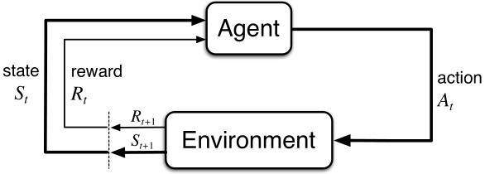
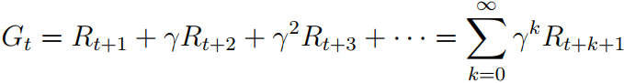
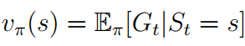
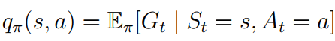
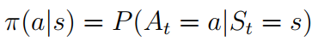
2. Background
Markov Decision Process (MDP)
Goodness of a state: Expected returns
Optimal State-value func v*:
Optimal Action-value func q*:
Goal: Find optimal policy(ies) π*
Environment dynamics
Known
Unknown
Solve system of Bellman equations
Finite # states
Infinite # states
Costly, sometimes impossible to solve! In practice: Dynamic Programming (DP)
Monte-Carlo (MC)
Temporal-Difference (TD)
Actor-Critic Models
Our case
Notes:
There are 2 main factors in a MDP: an agent and an env. Agent interacts with env by making actions, receives rewards from env, then learns way of making actions to maximize received rewards.
To evaluate goodness of a state or an action in a state, we define the value function. First, v is value function of state s under policy π is expected return if we start at s then follow π thereafter
Next, q is value of taking action a in state s under policy π is expected return if we start at s and follow π thereafter
Expression inside argmax is a weighted sum of discounted next state’s optimal value plus reward expected along way.

Slide 7
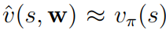
2. Background
Value function approximation
Problem: Stock price is continuous ➡ Infinite MDP ➡ Approximate value functions
w: value function’s weight vector
Policy Gradient
Directly parameterize policy
θ: policy’s weight vector
Actor-Critic Model = Value function approximation + Policy Gradient
Learnt by critic
Learnt by actor
Notes:
All methods considered so far learn values of actions and choose action based on estimated action values; policies do not exist without action-value estimates. Now we consider another method that learns a parameterized policy which can choose actions without value functions. A value function can still be used to learn policy parameters, but not necessary for choosing actions.
Methods learning approximations to both policy and value functions are called Actor-Critic methods, in which actor learn policy and critic learn value function, usually the state-value function.

Slide 8
3. Models
Actor-Critic Models
On-policy* models
target policy = behavior policy
Off-policy** models
target policy ≠ behavior policy
Advantage Actor-Critic (A2C) [1]
Stabilized and improved policy gradient
Deep Deterministic Policy Gradient (DDPG) [3]
Combined DPG and Deep Q-Network (DQN)
Proximal Policy Optimization (PPO) [2]
Improved Trust Region Policy Optimization (TRPO)
Twin Delayed DDPG (TD3) [4]
Direct successor of DDPG with 3 improvements
* On-policy methods: evaluate and improve policy that is used to make actions
** Off-policy methods: evaluate and improve a policy that are different from the policy used to make actions
[1] V. Mnih et. al., “Asynchronous methods for deep reinforcement learning,” in International conference on machine learning. PmLR, 2016, pp. 1928–1937.
[2] J. Schulman et. al., “Proximal policy optimization algorithms,” arXiv preprint arXiv:1707.06347, 2017
[3] T. P. Lillicrap et. al., “Continuous control with deep reinforcement learning,” arXiv preprint arXiv:1509.02971, 2015.
[4] S. Fujimoto et. al., “Addressing function approximation error in actor-critic methods,” in International conference on machine learning. PMLR, 2018, pp. 1587–1596.

Slide 9
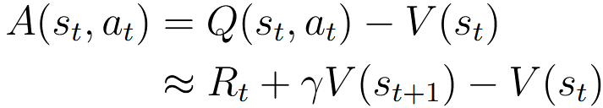
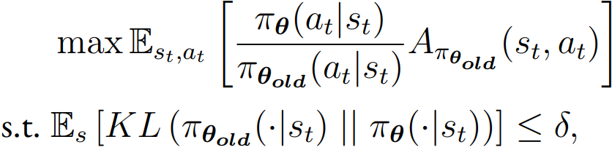
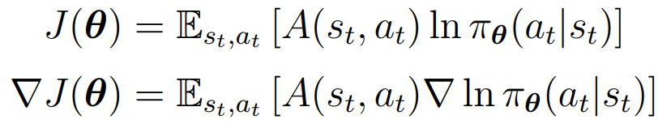
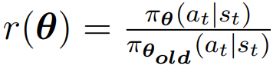
3. Models
On-policy models
Advantage Actor-Critic (A2C)
Issue: High variance in policy gradients
A2C’s proposal: “Advantage”
Actor updates θ
Critic updates w
Proximal Policy Optimization (PPO)
TRPO’s goal: Stabilize policy updates
TRPO optimization (actor)
Issue: Costly due to KL constraint
PPO’s proposal: Clipped surrogate objective
Expected advantage-weighted prob ratio of current policy over old policy
expected advantage-weighted log prob of selected actions
Constraint on KL divergence between new and old policy distributions
Prevents large policy shifts
Integrated KL constraint
Controls range of policy updates
Notes:
A2C is designed to stabilize and improve policy gradient methods by reducing variance in policy updates. Paper argued that using a simple value function as a baseline can lead to high variance in policy gradients. To address this issue, A2C used advantage A(st, at) of action at in state st, defined as the difference between action-value function and state-value function:
Actor updates policy parameter θ by maximizing expected advantage-weighted log probability of selected actions
Critic updates its parameters w by minimizing mean squared error
PPO is developed as an improvement over TRPO, aiming to simplify implementation while retaining the stability and performance. The critic in PPO updates in the same way as A2C.
TRPO seeks an optimization objective that ensures stable policy updates by imposing a constraint on KL-divergence between new and old policy distributions. TRPO aims to maximize expected advantage-weighted probability ratio of current policy over old policy. Purpose of KL divergence constraint is to prevent large policy shifts, ensuring that policy updates remain within a trusted region defined by threshold δ.
Problem of TRPO is that it is computationally costly if we compute and enforce the KL constraint directly. PPO simplifies this constraint by introducing a clipped surrogate objective

Slide 10
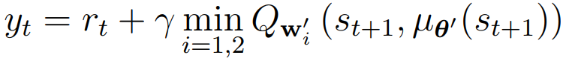
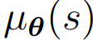
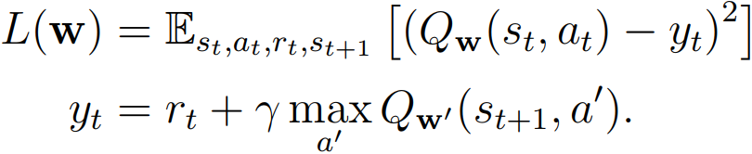
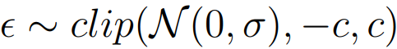
3. Models
Off-policy models
Deep Deterministic Policy Gradient (DDPG)
DPG
Issue: Curse of dimensionality in Q-learning
DPG’s proposal: Deterministic policy
DQN: Use a separate net w’ to estimate Q func
DDPG: DPG + DQN + Replay Buffer
Twin Delayed DDPG (TD3)
DDPG + 3 improvements
Clipped Double Q-learning
Target Policy Smoothing
Delayed Policy Updates
Actor and 2 target networks are updated after critic has been updated d times
2 critic networks
Reduces overestimation bias
noise
Reduces overfitting
Integrated actor net
Improves learning stability
Notes:
DPG is developed to address curse of dimensionality issue in Q-learning whose optimal policy is a probability distribution over actions. When action space is huge, training is intractable because training examples is minor compared to all possible states. DPG handles continuous space by implementing policies that directly output continuous actions instead of a distribution of actions.
DQN extend traditional Q-learning by using neural networks as function approximators to estimate the Q-value function. DQN uses a separate target network (parameters w′) periodically updated by the main critic network to compute the target value, and minimizes the TD error between the predicted Q-values and target Q-values
DDPG employ a technique called Experience Replay Buffer to store the experience st, at, rt, st+1, then sample randomly to reduce correlation among training samples
To mitigate the overestimation bias in the value function, TD3 uses two critic networks Qw1 and Qw2, each has a corresponding target network wi′, to compute the target value:
To reduce overfitting to narrow peaks in the value estimate, TD3 adds noise to the target policy. The added noise is clipped to keep the target in a small range

Slide 11
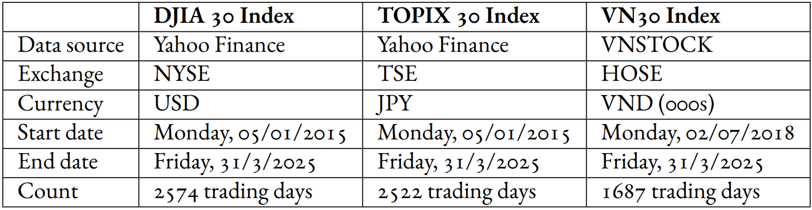
4. Experiments and Results
Indexes Data Summary
Datasets
🇺🇸 DJIA 30 Index
🇯🇵 TOPIX 30 Index
🇻🇳 VN30 Index
m=30 stocks
Data collected over last 10 years
Only 7 years due to lack of data
Experimental Settings
MDP state
Simulation settings
Max # buying shares for a stock per trade: 100
Initial cash: 🇺🇸 $1M, 🇯🇵 ¥10M, 🇻🇳 đ1B
Transaction fee: 0.1% trading value
Date of start trading 🇺🇸 🇯🇵 01/01/2021 🇻🇳 01/01/2023
Retrain models every 252/4=63 days
Current cash balance
Vector of current # owned shares
Vector of current closing prices
Technical indicators

Slide 12
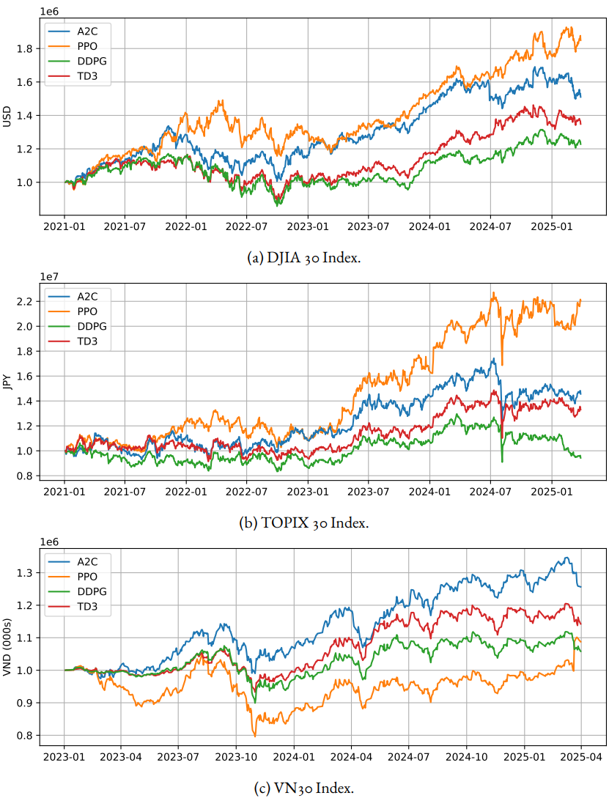
4. Experiments and Results
Results
Portfolio value evolution
PPO > A2C > TD3 > DDPG
Why On-policy (A2C, PPO) > Off-policy (DDPG, TD3)?
DDPG & TD3: use replay buffers to squeeze gradient steps ➡ May introduce noisy and wrong targets ➡ Policy is pulled toward obsolete Q value
A2C & PPO: update only based on most recent trajectory ➡ Critic observes same env as actor will behave in next step
On-policy > Off-policy
A2C > TD3 > DDPG > PPO
PPO underperformed
Notes:
US and Japan markets have same patterns, as 2 on-policy models PPO and A2C outperform other 2 off-policy ones TD3 and DDPG.
Vietnam market shows a different pattern, where A2C is best model and PPO is the worst one.
Q1
Off-policy algorithms like DDPG and TD3 use replay buffers to squeeze gradient steps of each sample, but in stock trading environment, keeping stored transitions in buffers may introduce noisy and probably wrong training targets. As Q-networks try to fit this drifting mixture of old and new data, they develop bias, so policy is pulled toward actions that looked good but actually, state-action value is now obsolete. On-policy methods like A2C and PPO overcome that distribution mismatch by updating only based on the most recent trajectory. These methods sacrifice sample efficiency but gain stability because critic observes same environment as actor will behave in next step.
Q2
PPO clips the surrogate loss to limit the update size, so it learns quickly but still keep the policy change smallt. A2C has similar actor-critic backbone as PPO, but it updates policy using only a single-step return, making it subordinate to PPO. TD3 is a direct improved version of DDPG with twin critics and delayed policy updates, so that it beats its parent DDPG easily. DDPG with a single critic and immediate policy updates seems to be underperformed

Slide 13
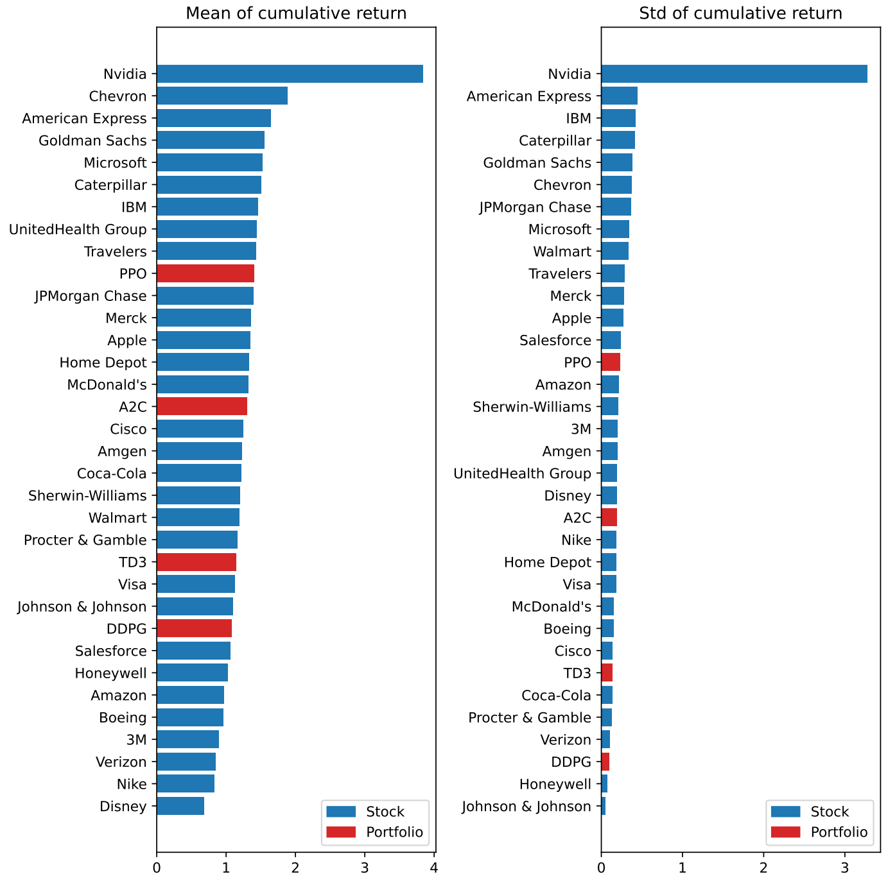
4. Experiments and Results
Mean and Volatility of Cumulative Returns (🇺🇸 US)
Higher return ➡ Higher std
Portfolio, in general: Rank of mean > Rank of std (preferred)
Why? ➡ Stock diversification
Q: Portfolio is not > all stocks. Why use it?
A: Reduced return volatility
Cannot say 100% which stock will make largest profit in future
We are risk-averse lower but stable > higher but risky
higher
is
better
lower
is
better

Slide 14
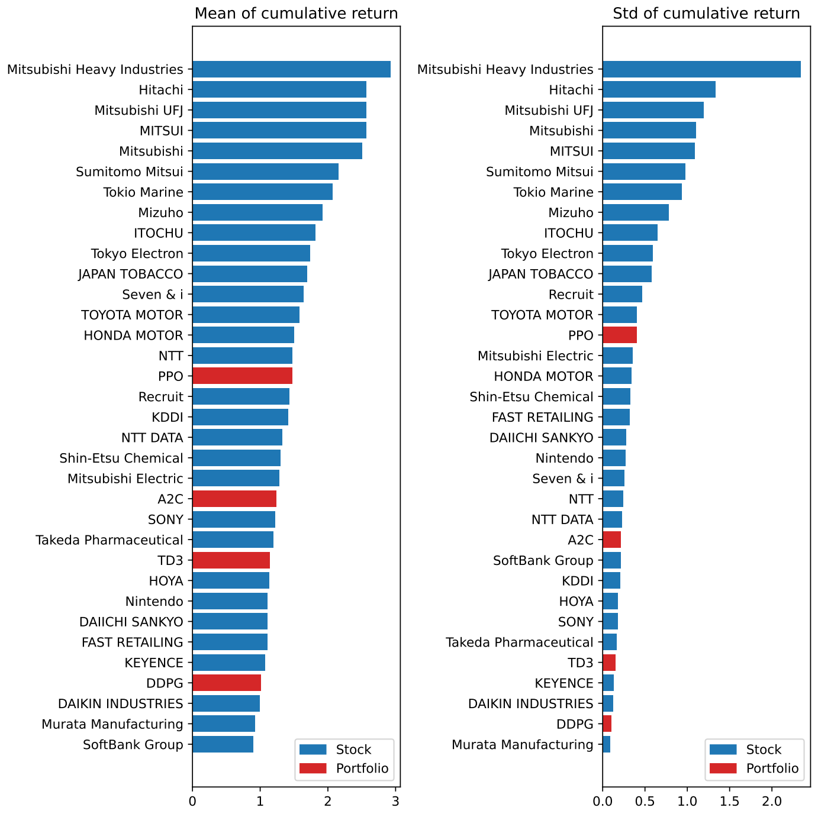
4. Experiments and Results
Mean and Volatility of Cumulative Returns (🇯🇵 JP)
Similar observations
Exception: PPO

Slide 15
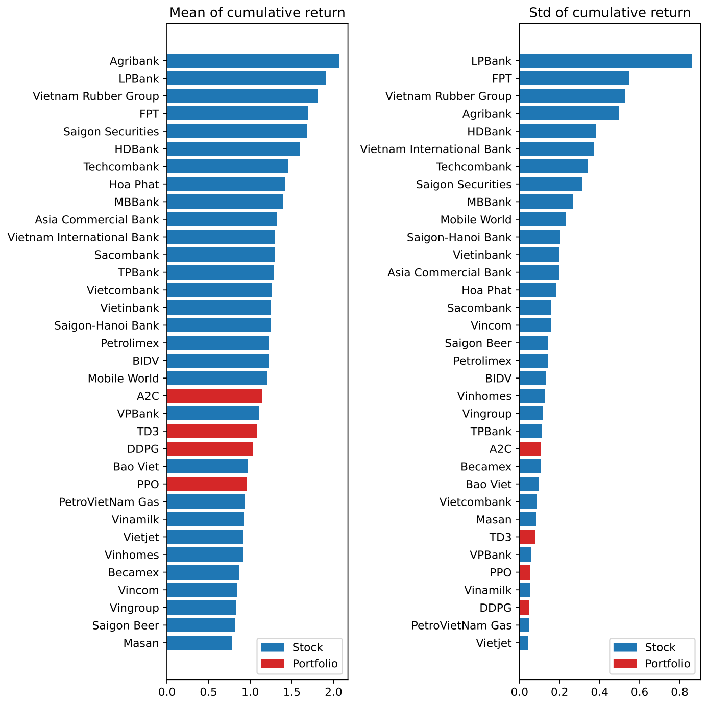
4. Experiments and Results
Mean and Volatility of Cumulative Returns (🇻🇳 VN)
Similar observations
Exception: PPO underperformed

Slide 16
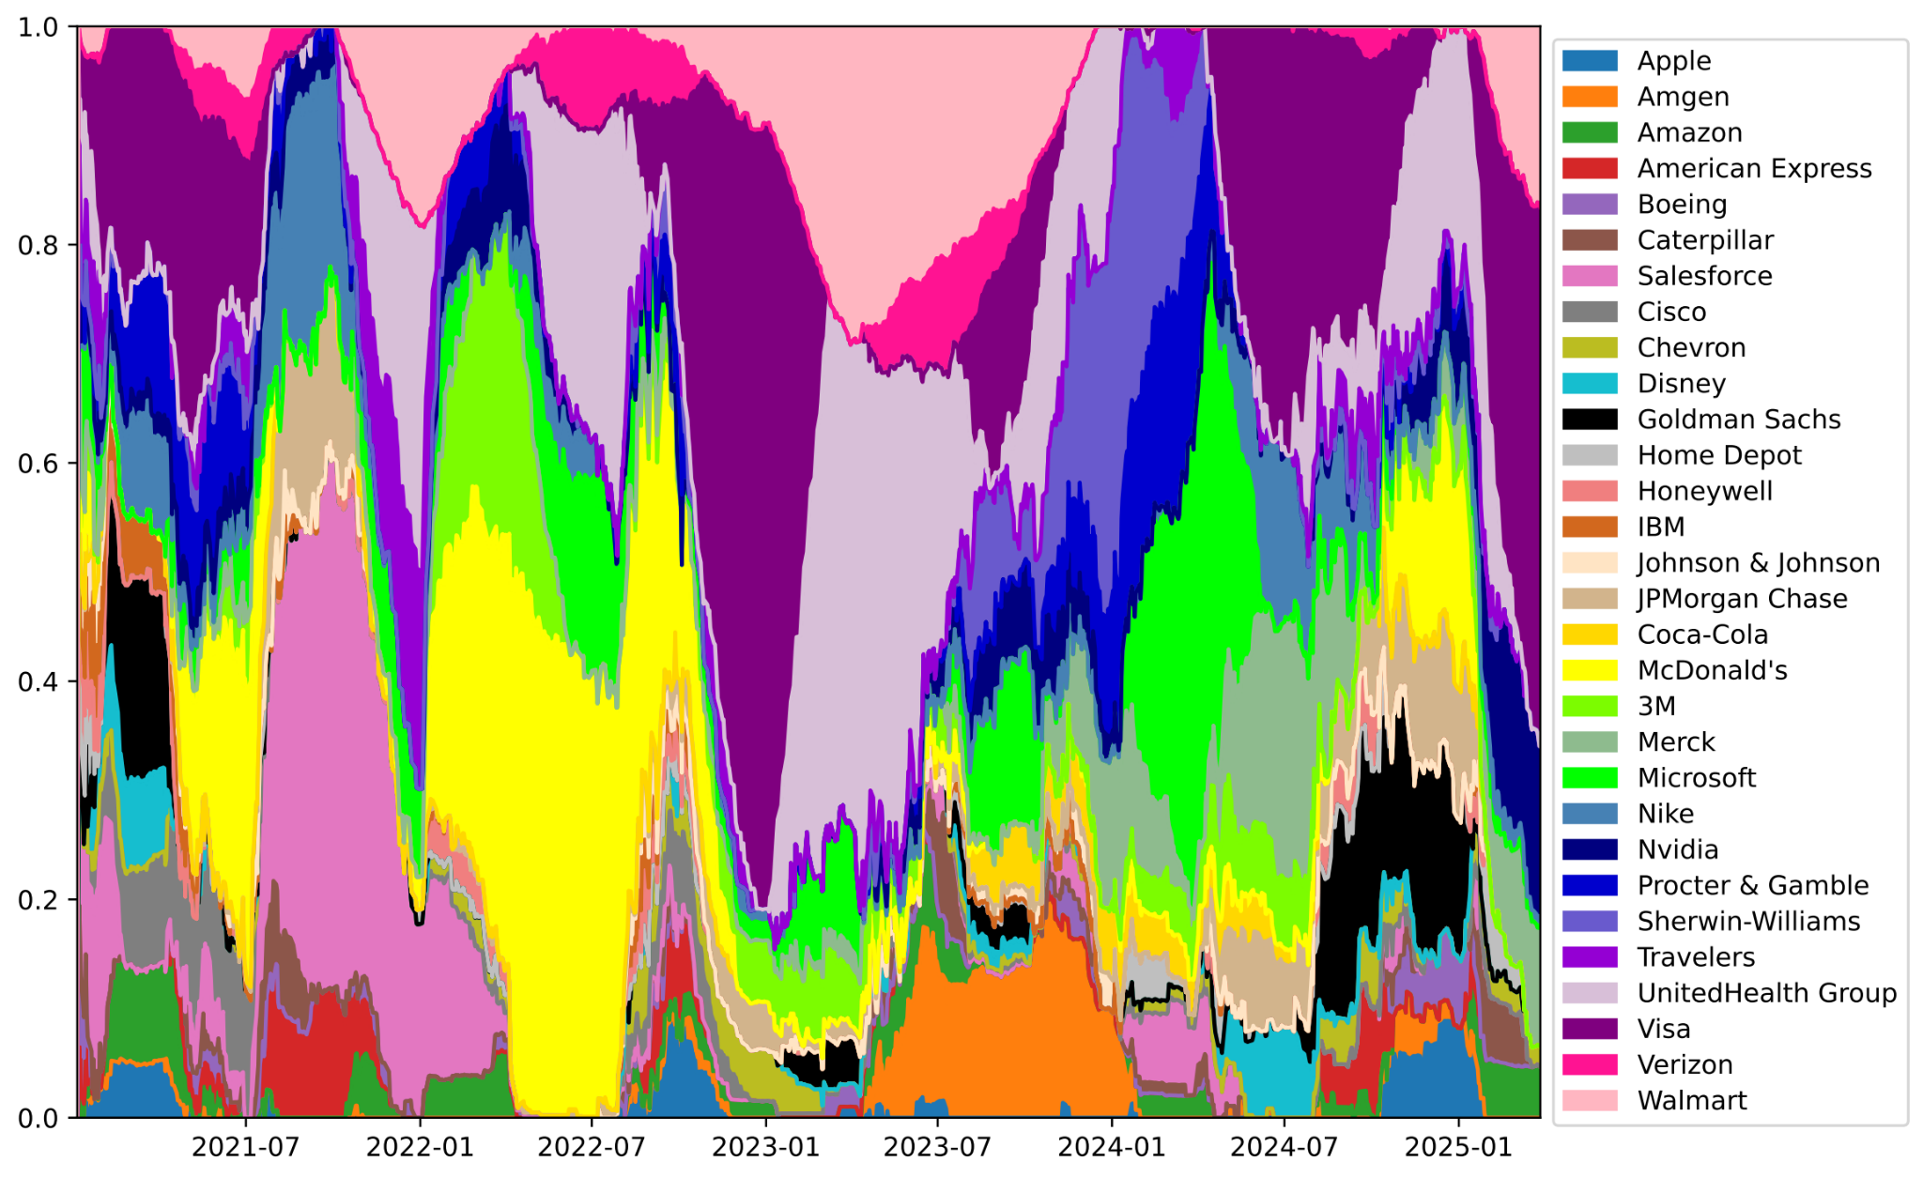
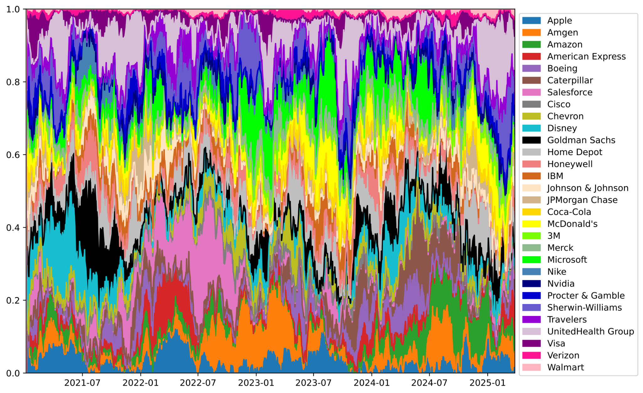
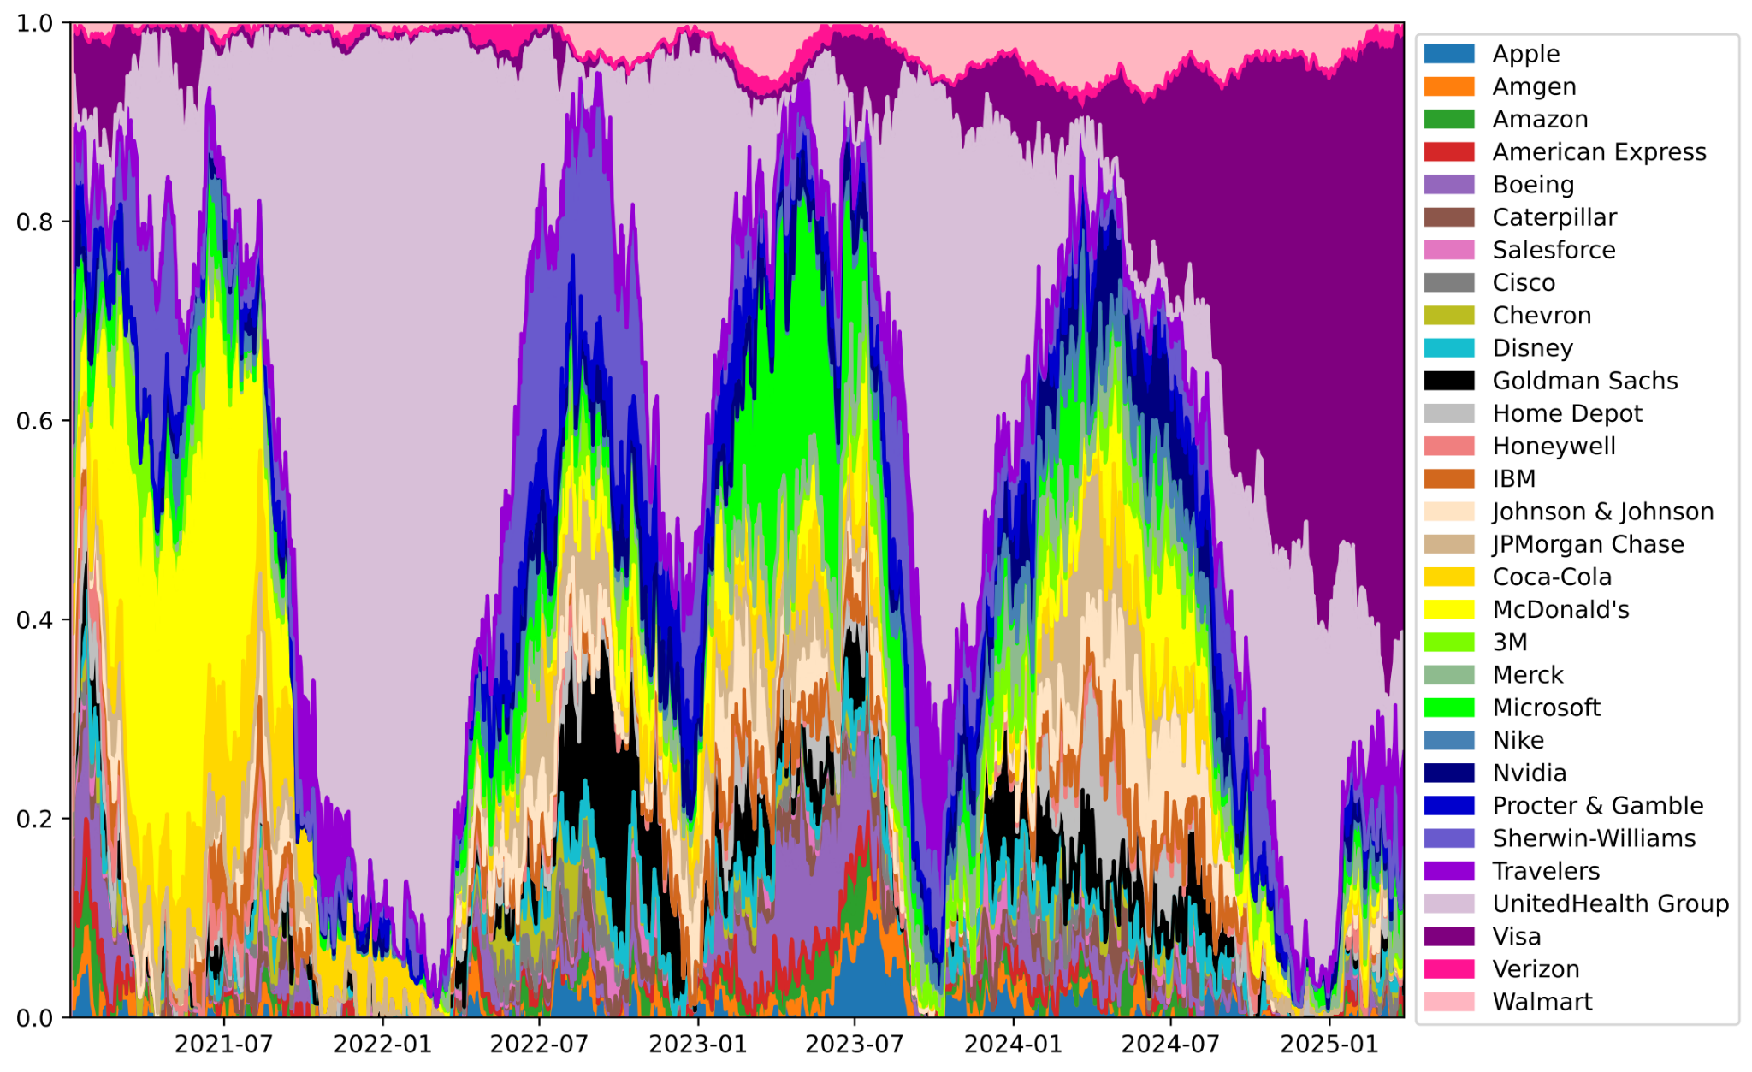
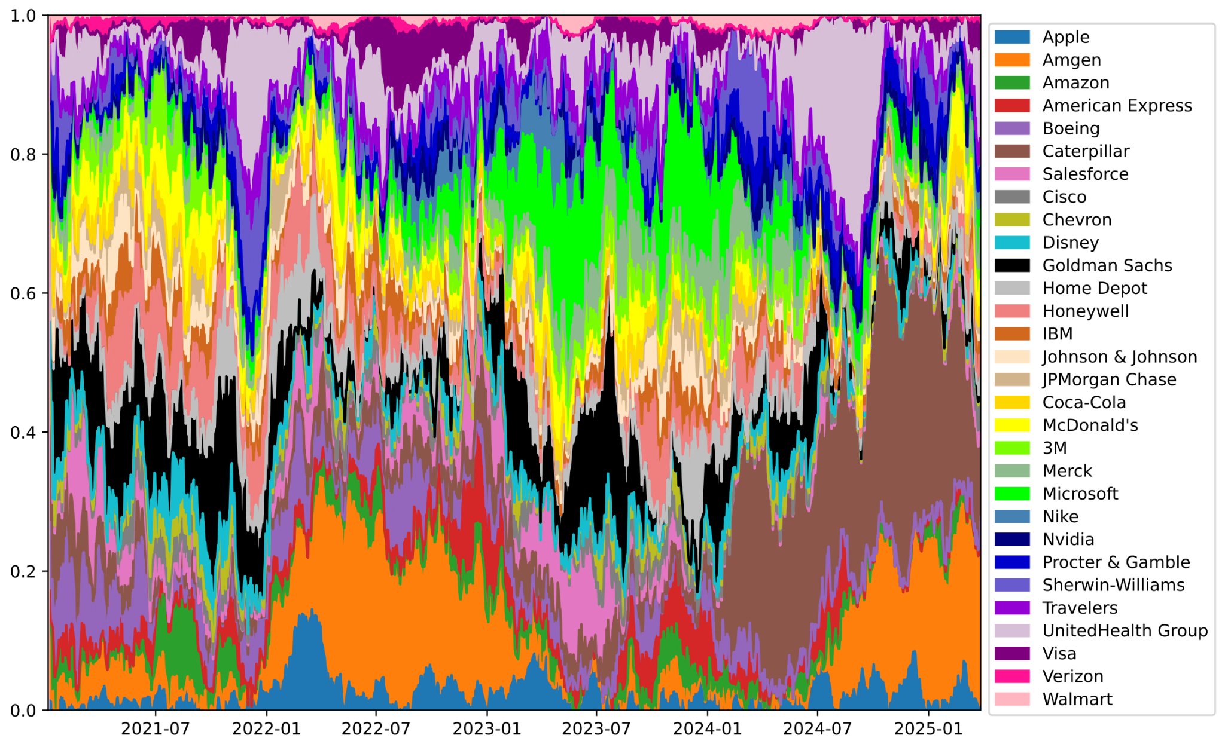
4. Experiments and Results
Evolution of Portfolio Weight Distribution over Time (🇺🇸 US)
A2C & PPO found same dominated stocks
UnitedHealth Group
Visa
McDonald
DDPG & TD3 did not have clear dominated areas
Weights are more evenly distributed
A2C
DDPG
On-policy
Off-policy
PPO
TD3
Notes:
2 on-policy approaches A2C and PPO were able to find dominated stocks in portfolio, namely UnitedHealth Group (thistle), Visa (purple), and McDonald (yellow). Distributions generated by 2 methods are different, but in general, both agrees with each other on those three dominated stocks.
DDPG and TD3 do not generate clear dominated areas like A2C and PPO; the portfolio weights are distributed more evenly without any prominent stock.

Slide 17
4. Experiments and Results
Revisit Cumulative Returns (🇺🇸 US)
A2C
PPO
Notes:
If we go back to Figure, we can see that those chosen stocks are in middle of both mean and volatility of cumulative return, meaning that A2C and PPO have invested in stocks having a balance of return and volatility.

Slide 18
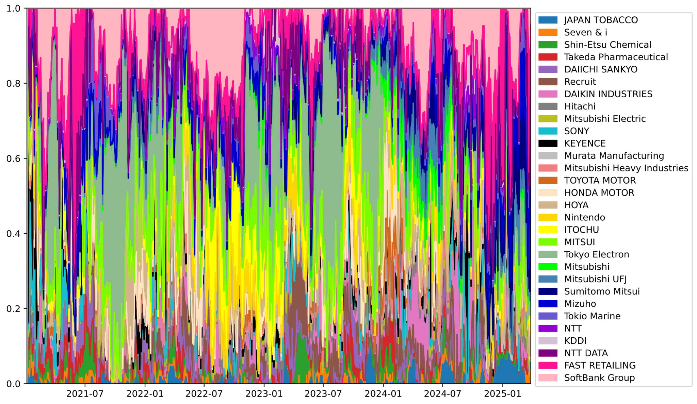
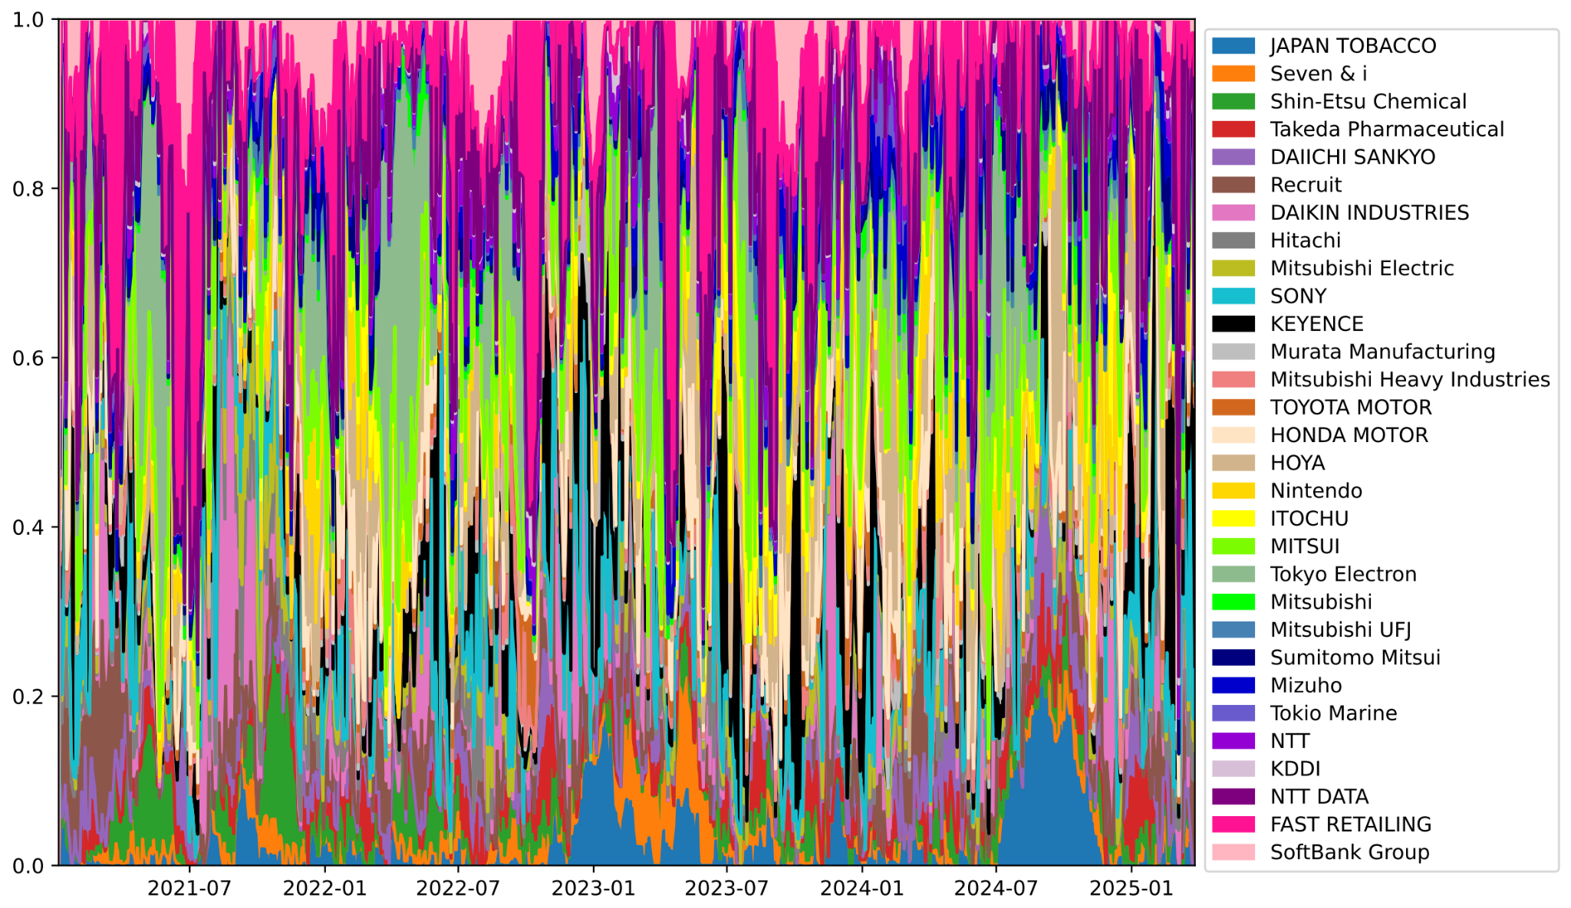
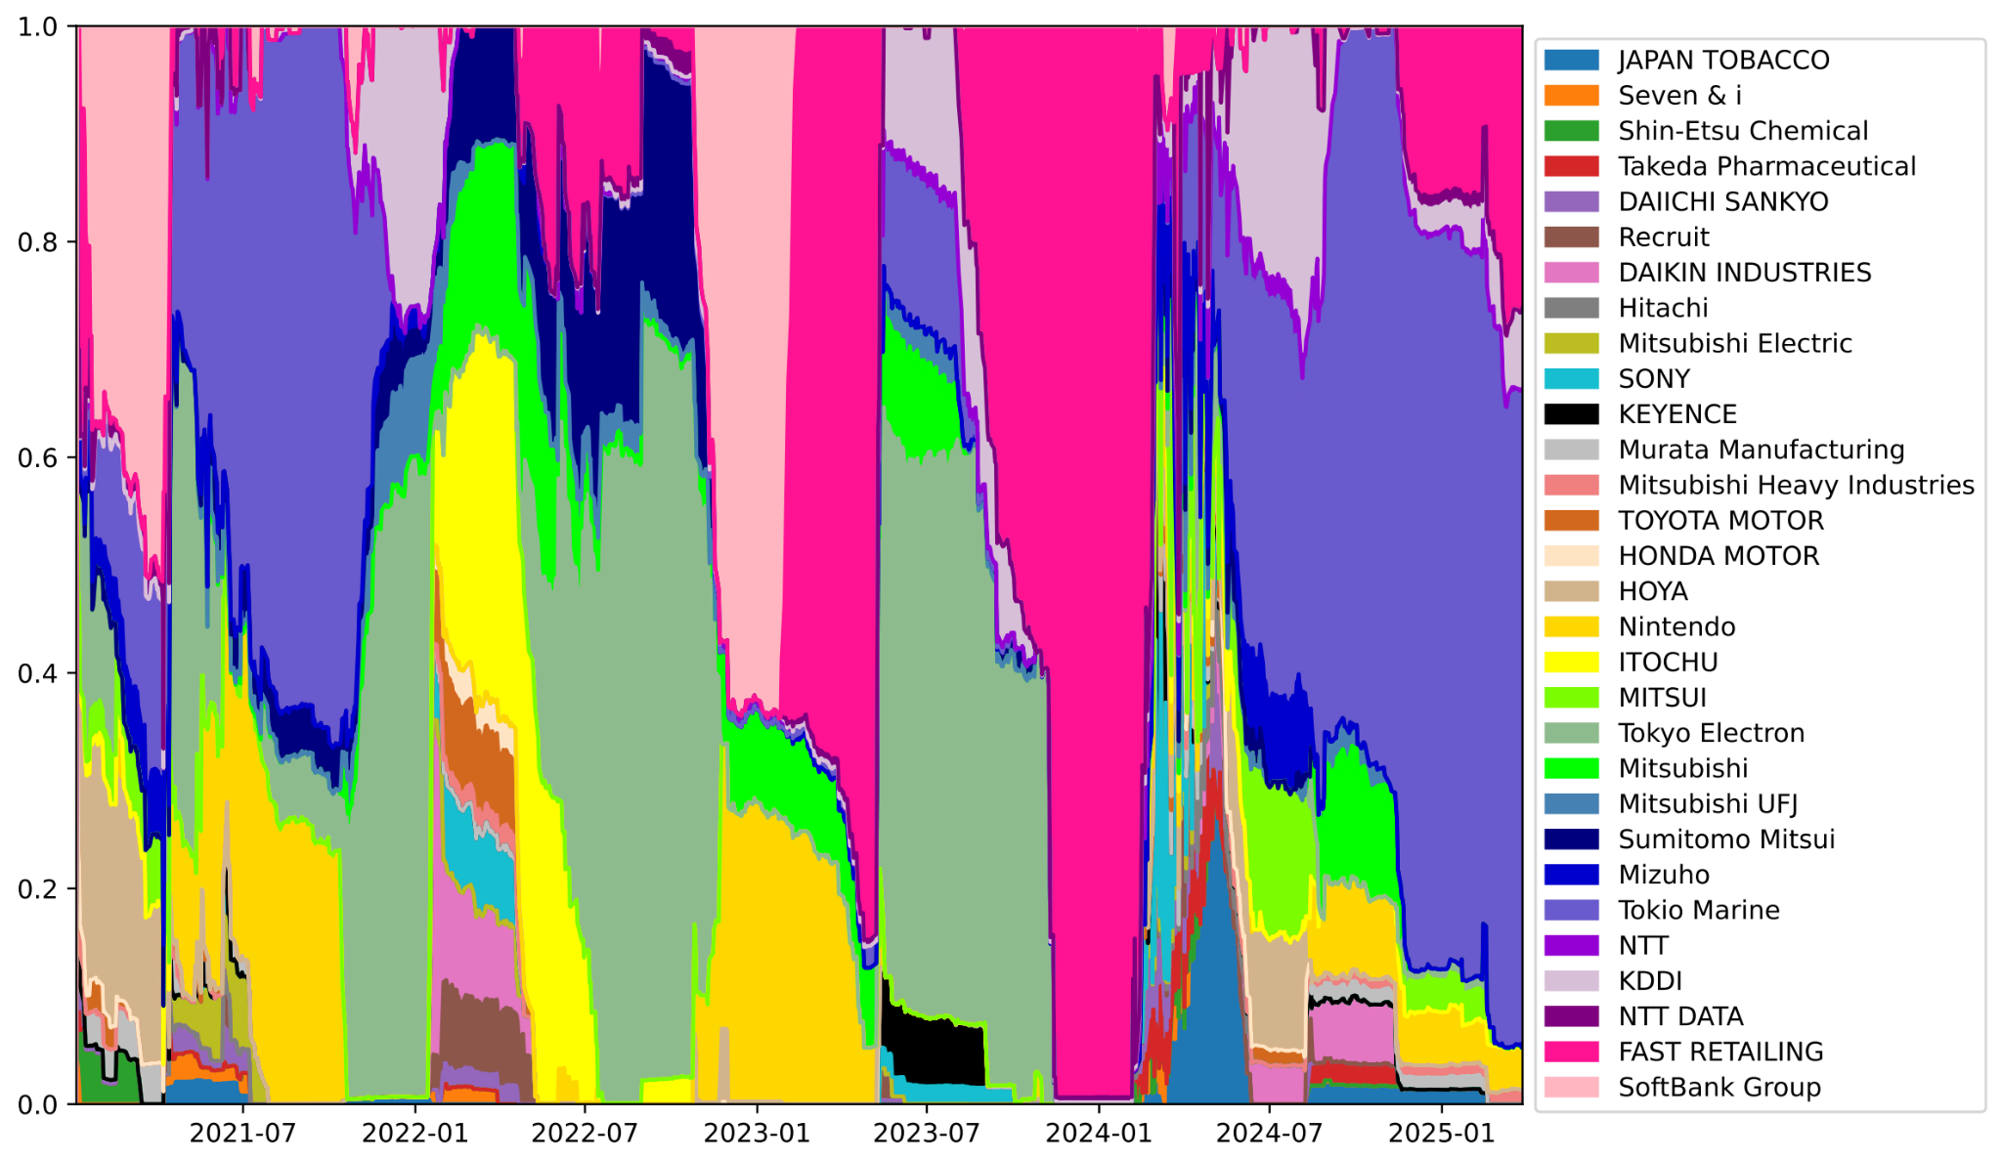
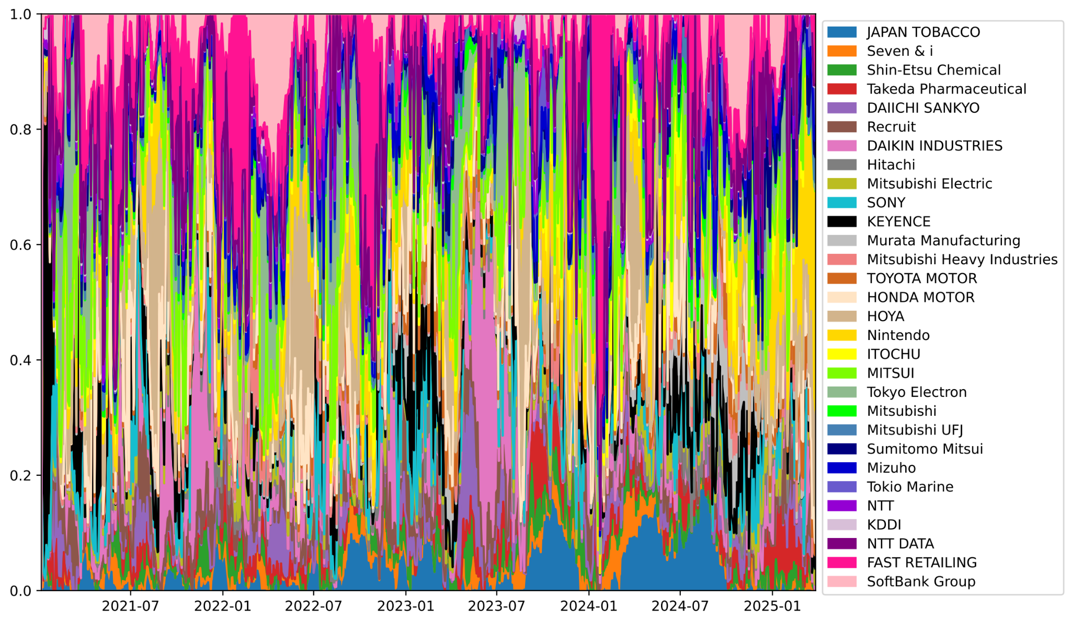
4. Experiments and Results
Evolution of Portfolio Weight Distribution over Time (🇯🇵 JP)
A2C more evenly distributed than PPO
A2C & PPO shared same dominant stocks
SoftBank Group
Tokyo Electron
PPO’s dominant areas are more clear than A2C’s
DDPG & TD3: Similar to 🇺🇸 US
A2C
DDPG
On-policy
Off-policy
PPO
TD3
Notes:
Behaviors of DDPG and TD3 are similar to DJIA 30 Index as they produce somewhat evenly distributed weights with ups and downs.
A2C does not really prioritize any stock.
Only PPO was able to find clearly dominated stocks to invest in

Slide 19
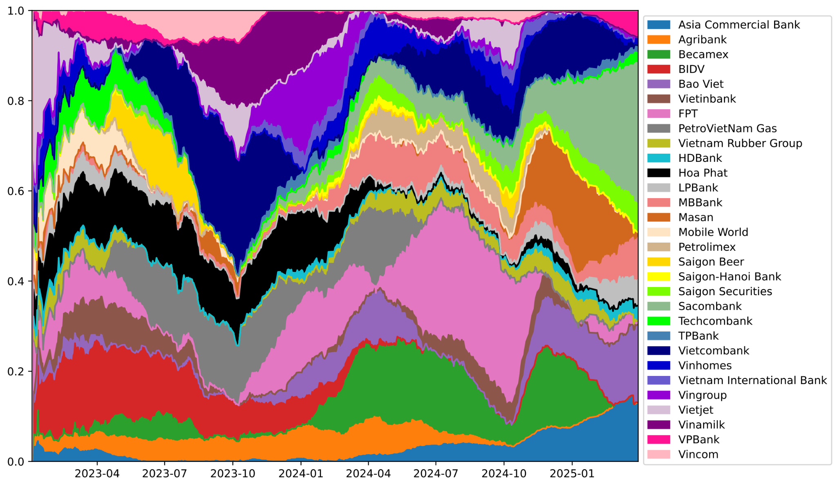
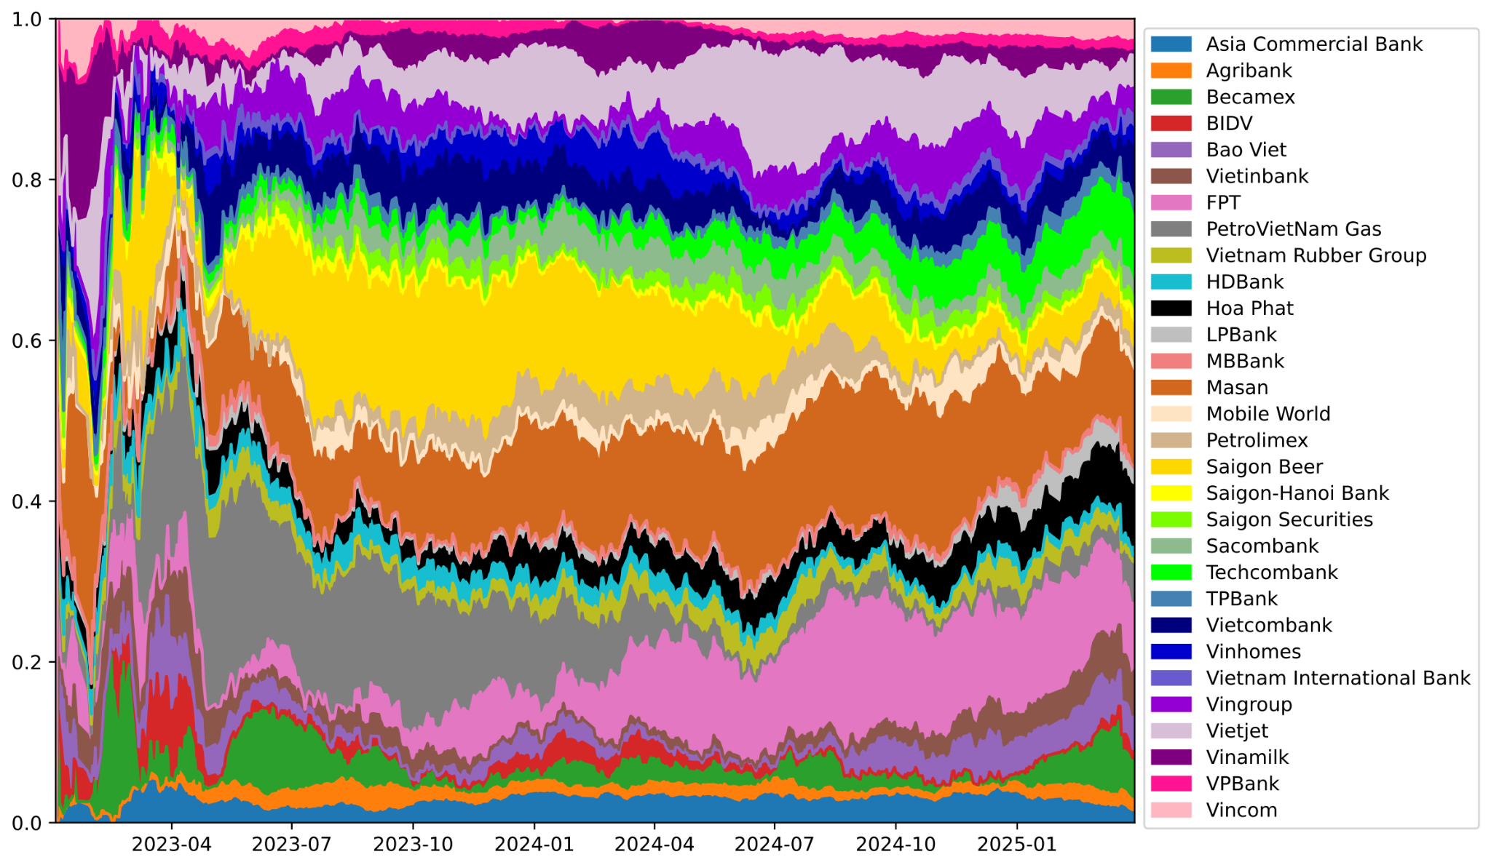
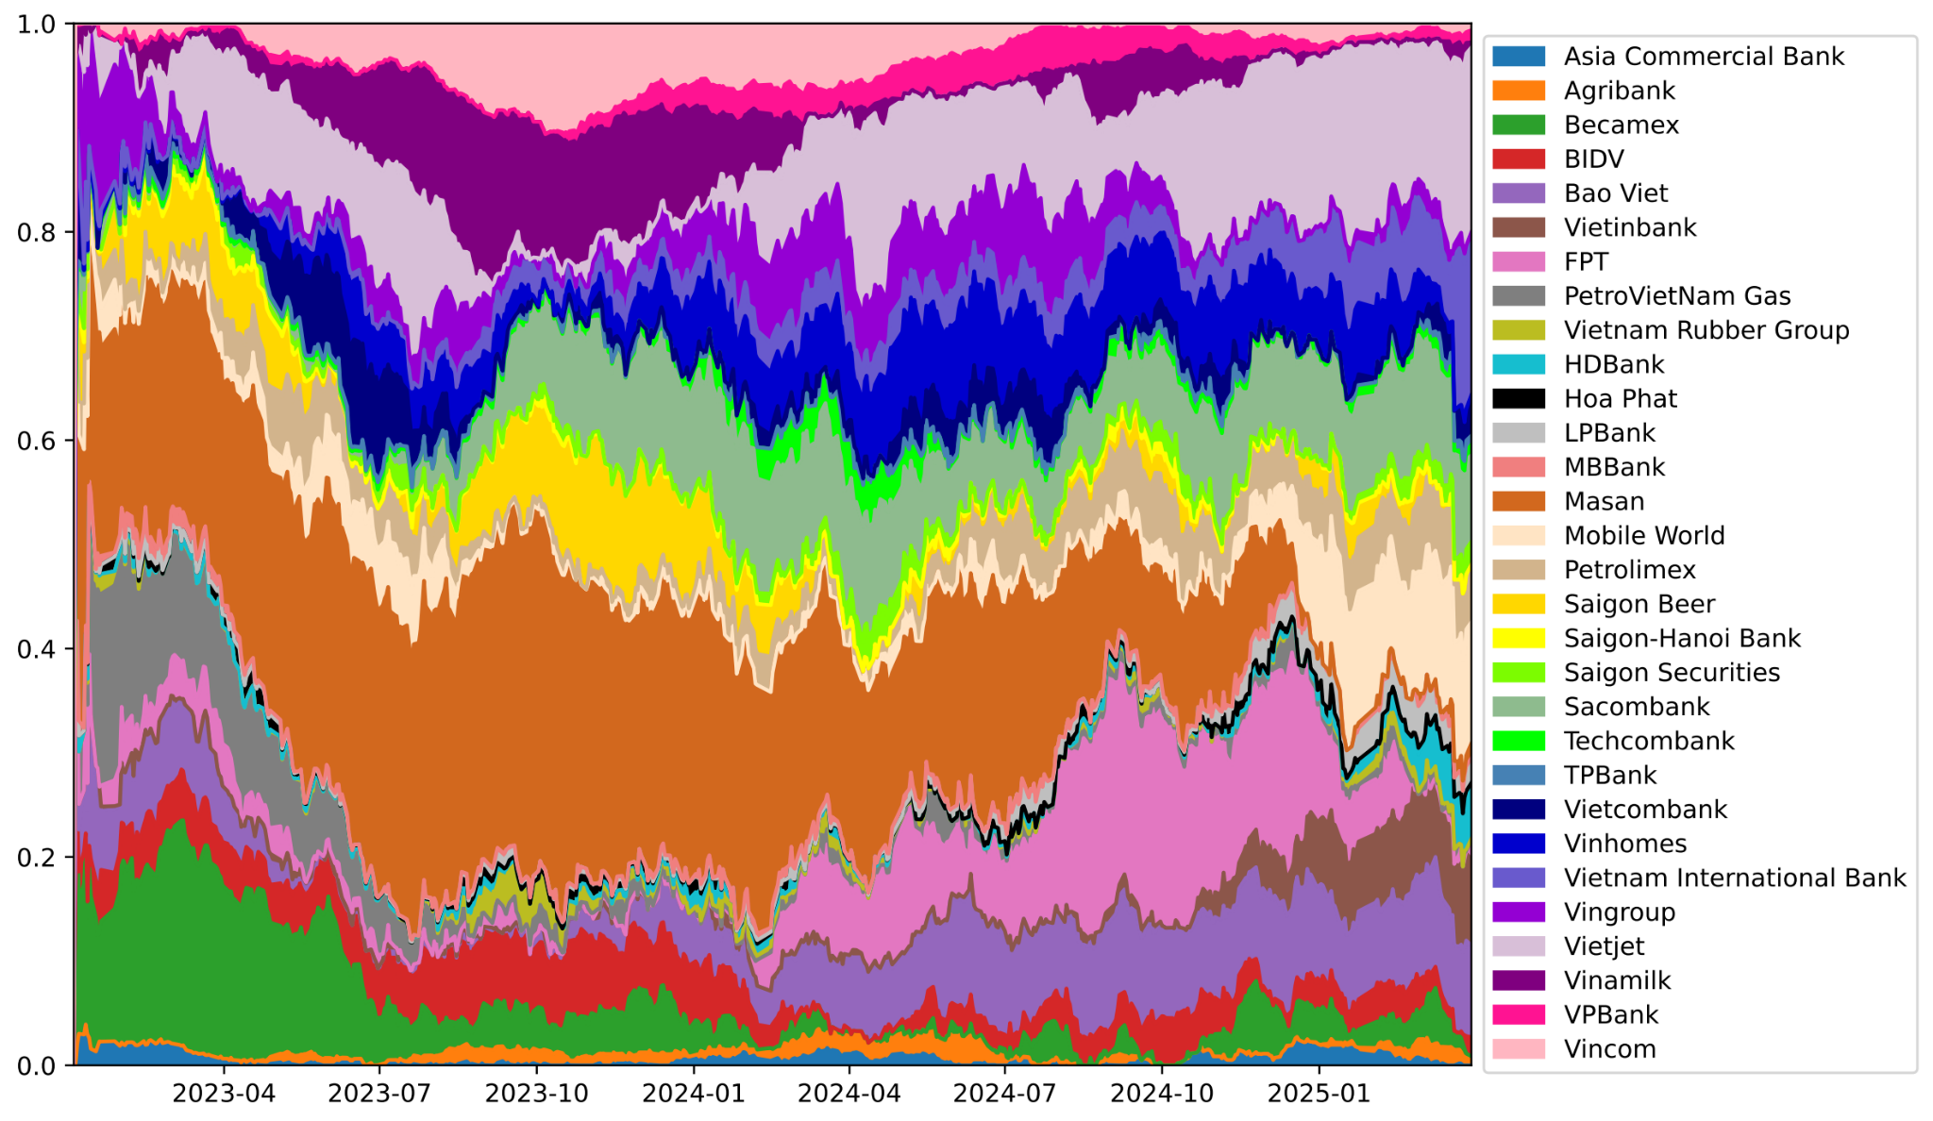
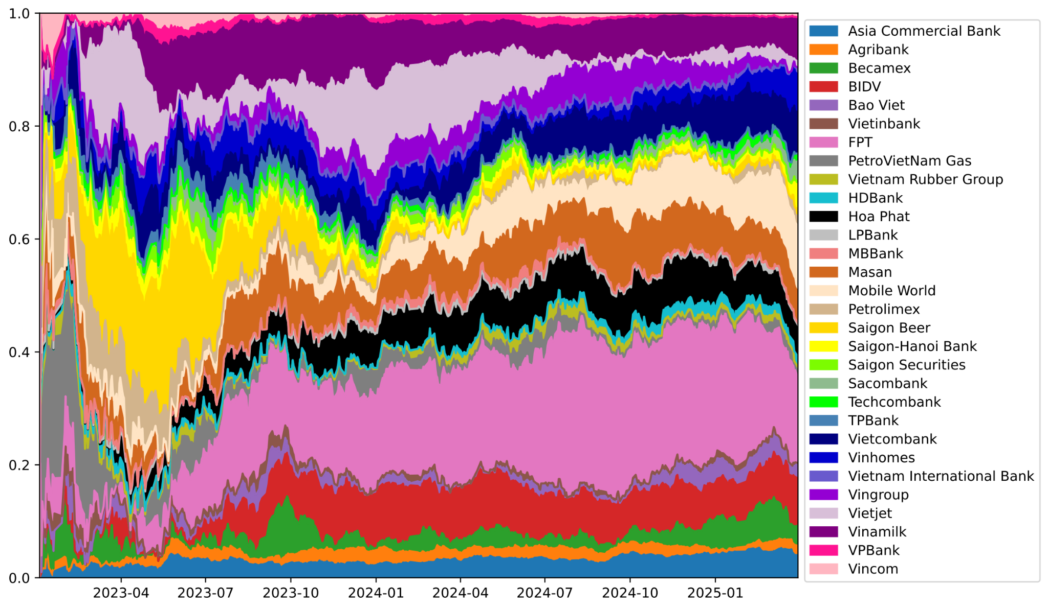
4. Experiments and Results
Evolution of Portfolio Weight Distribution over Time (🇻🇳 VN)
Common patterns in 4 models: horizontal bands
Only A2C relocated weights effectively
PPO, DDPG, TD3: Dominated stocks did not change much throughout years
A2C
DDPG
On-policy
Off-policy
PPO
TD3
Notes:
A common patterns among 4 models is horizontal bands of some dominated stocks that lasts for years, i.e. there are only a few stocks that dominated portfolio throughout trading period. This pattern is clearer in PPO, DDPG, and TD3 where dominated stocks occupied almost whole trading period.
This means those methods have not learned to redistribute constituent weights based on market stock values.
Only A2C was able to reallocate portfolio weights effectively, as can be seen through up-and-down areas. Nevertheless, as amount of training data in VN Index are much less than that in DJIA and TOPIX indexes, we cannot say for sure whether PPO can work for Vietnam market.

Slide 20
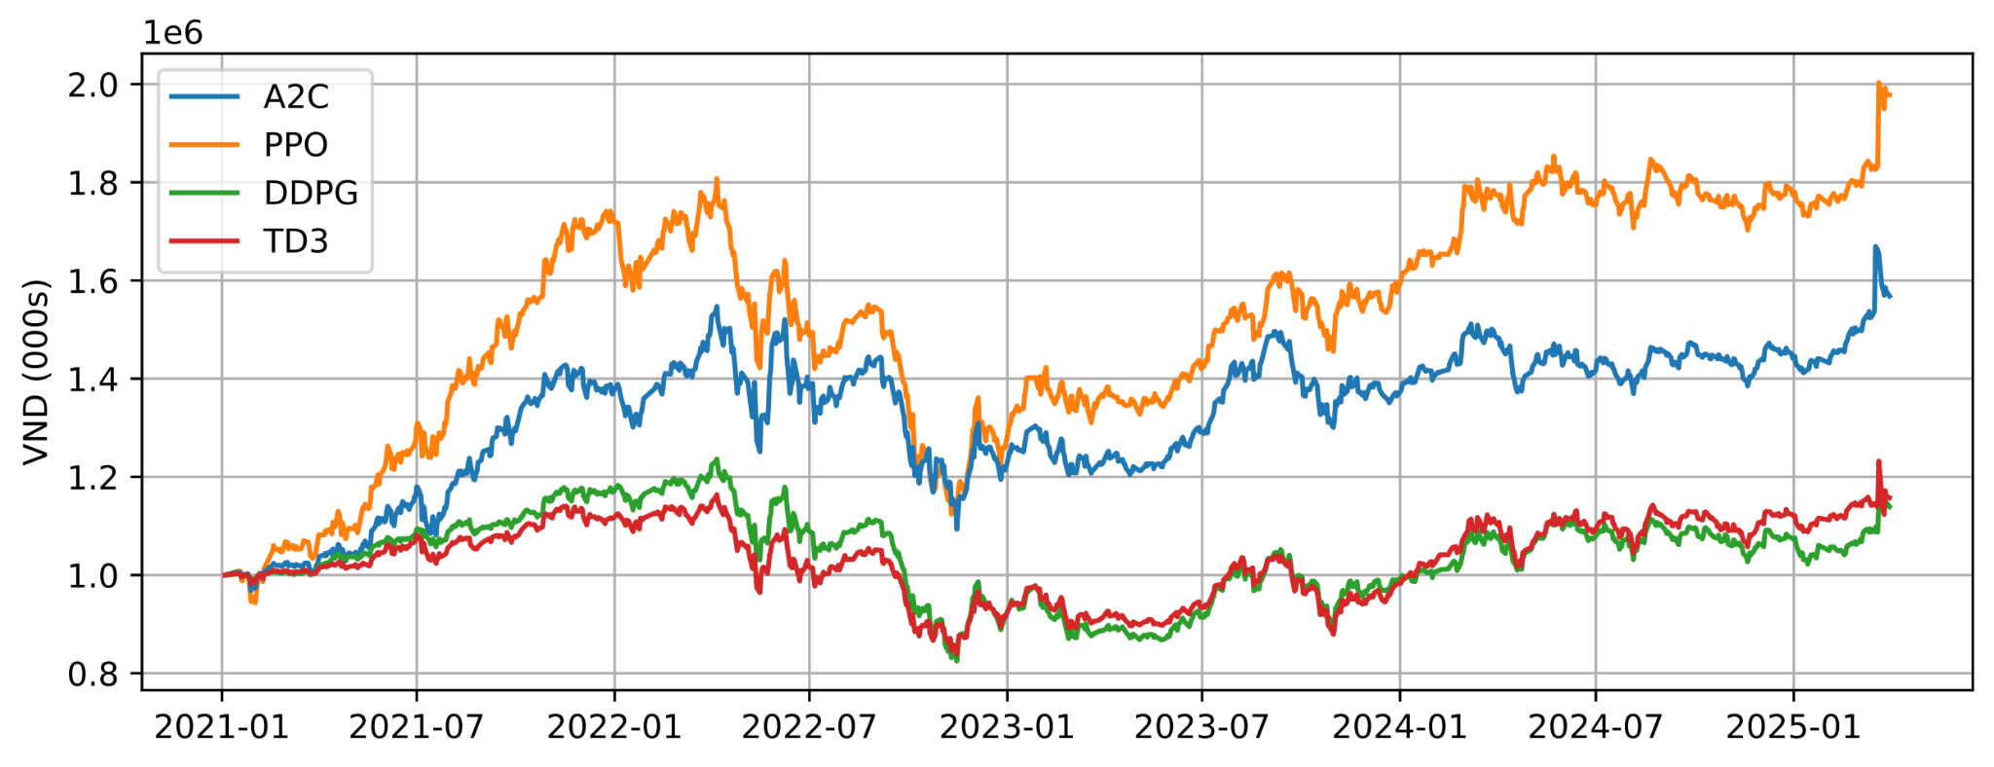
4. Experiments and Results
Extra experiment (🇻🇳 VN)
So far: PPO > A2C > TD3 > DDPG in 🇺🇸 US & 🇯🇵 JP
PPO did not work in 🇻🇳 VN ➡ Insufficient training data?
➡ Collect top 30 VN stocks published before 2015 (≠ VN30 index)
Run experiment again
Results
PPO outperformed others
Consistent with 🇺🇸 US & 🇯🇵 JP
Portfolio value evolution
Notes:
As expected, now PPO stands first followed by A2C, while TD3 and DDPG are similar. This observation is consistent with what we have seen in DJIA 30 and TOPIX 30 indexes, confirming that PPO is dependent on large amount of data to perform well.

Slide 21
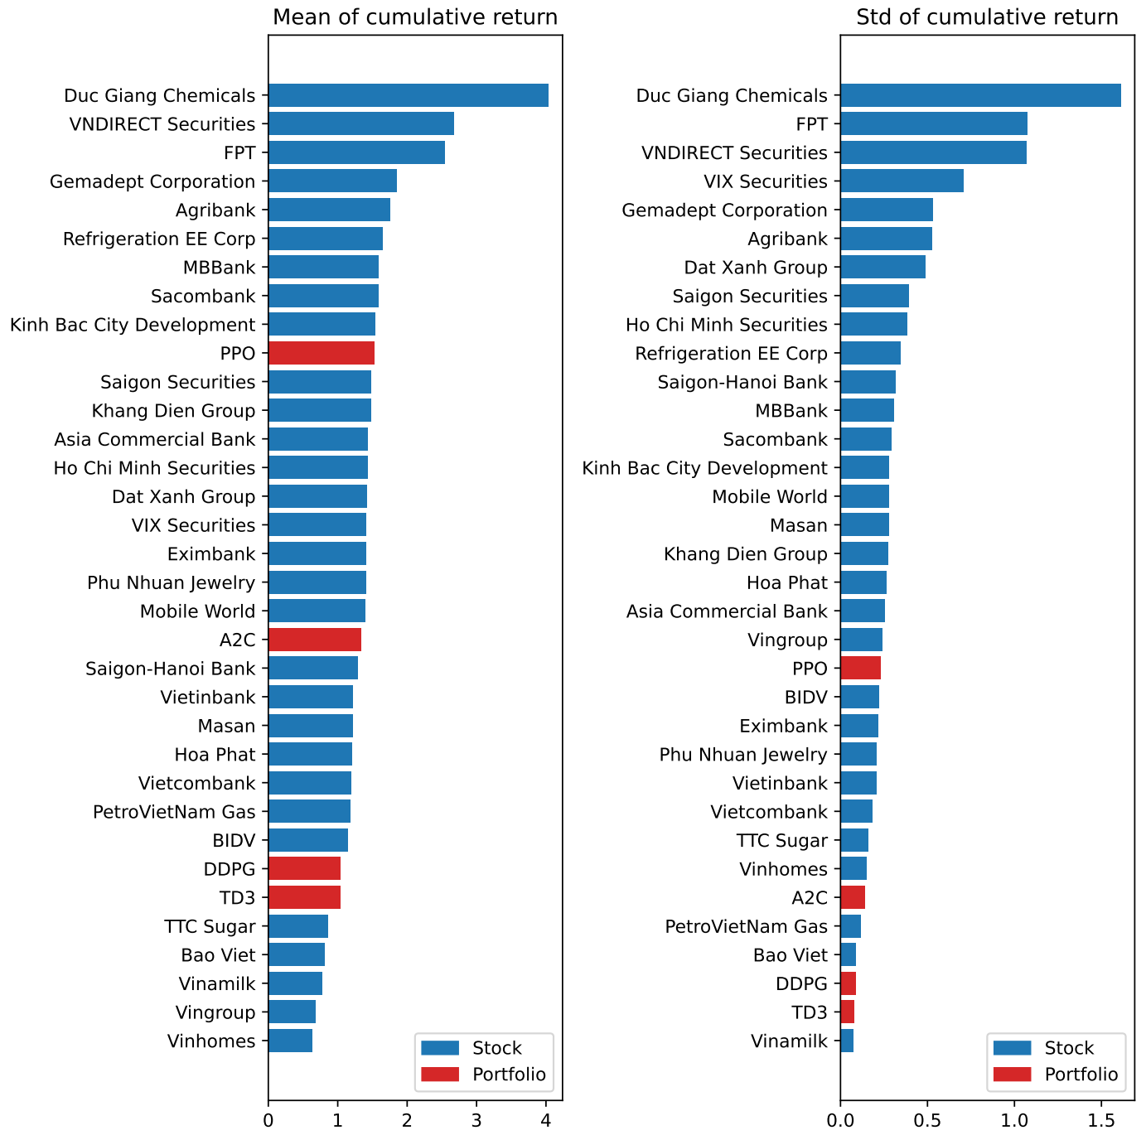
4. Experiments and Results
Portfolio, in general: Rank of mean > Rank of std (preferred)
Consistent with 🇺🇸 US & 🇯🇵 JP
Mean and Volatility of Cumulative Returns

Slide 22
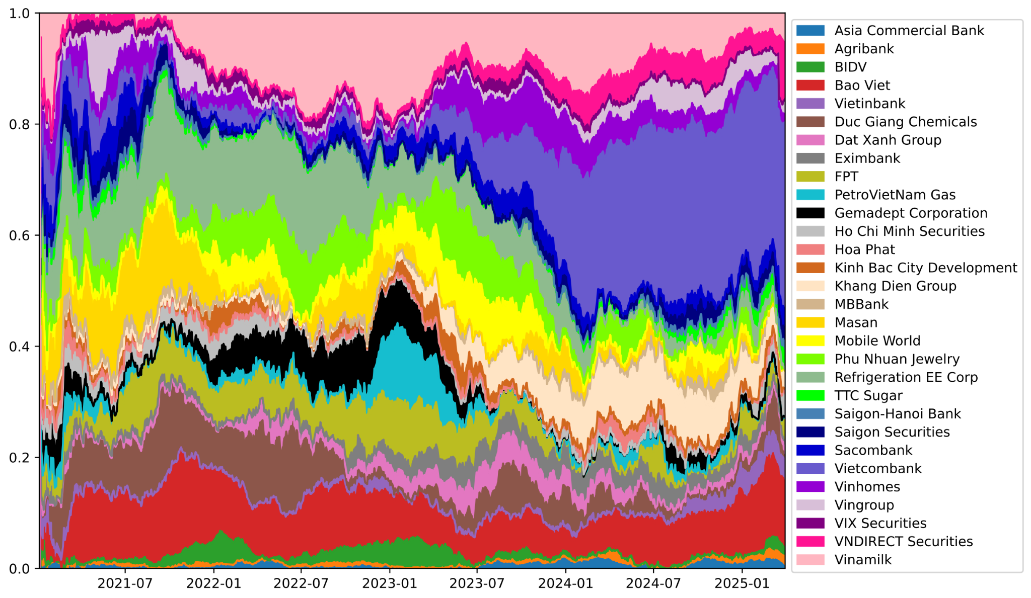
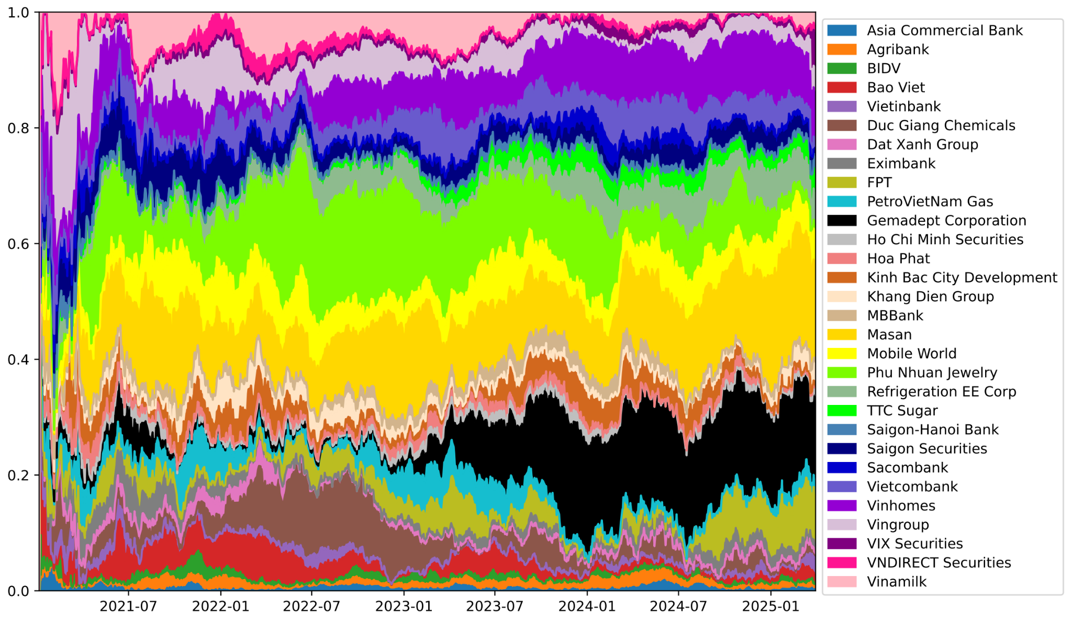
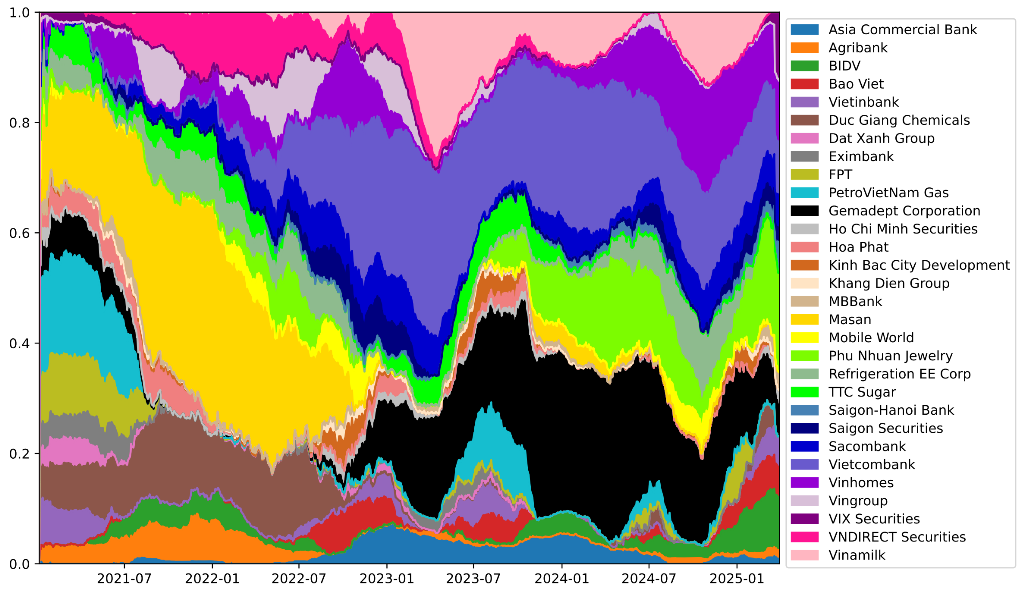
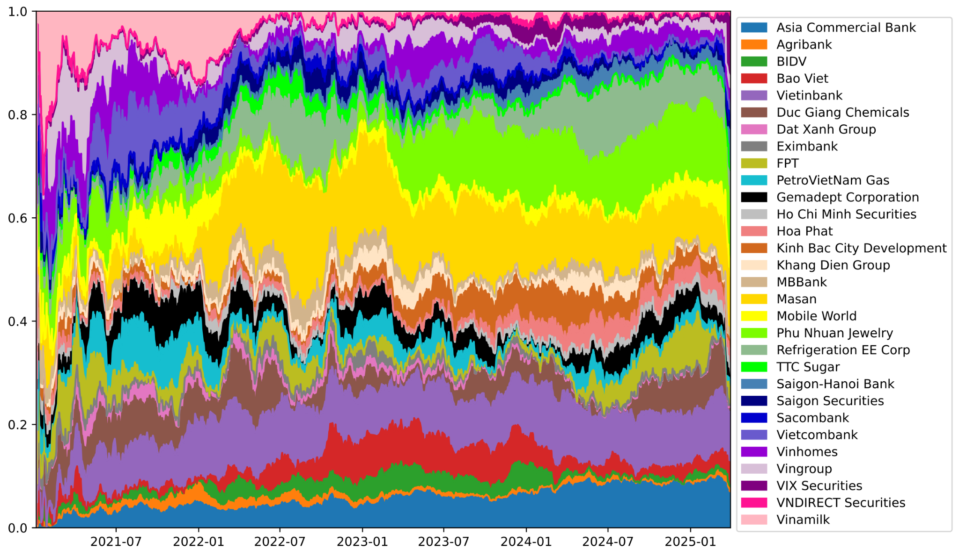
4. Experiments and Results
Evolution of Portfolio Weight Distribution over Time
A2C & PPO found same dominated stocks:
Vietcombank
Masan
Vinamilk
DDPG & TD3 still have trouble
Consistent with 🇺🇸 US & 🇯🇵 JP
A2C
DDPG
On-policy
Off-policy
PPO
TD3
Notes:
Overall, A2C and PPO have found out Vietcombank (slateblue) and Masan (gold) as optimal stocks to put large weights on. Meanwhile, DDPG and TD still have trouble in finding optimal stocks, so they tend to distribute weights evenly among stocks

Slide 23
5. Conclusions
Answering RQs
Is portfolio better than buy-and-hold on a stock? Yes, given risk-averse investor
Optimal for each market?
On-policy (A2C, PPO) > Off-policy (DDPG, TD3)
PPO outperformed others, given sufficient data
Models’ pros and cons?
Explainability: Models ~ Black boxes
PPO requires sufficient data to work effectively
Possible future directions
Insights from financial news ➡ NLP
Explain generated decisions ➡ Explainable AI (XAI)
Real-time trading ➡ Continual Learning

Slide 24
Thank you!
Q&A

Slide 25
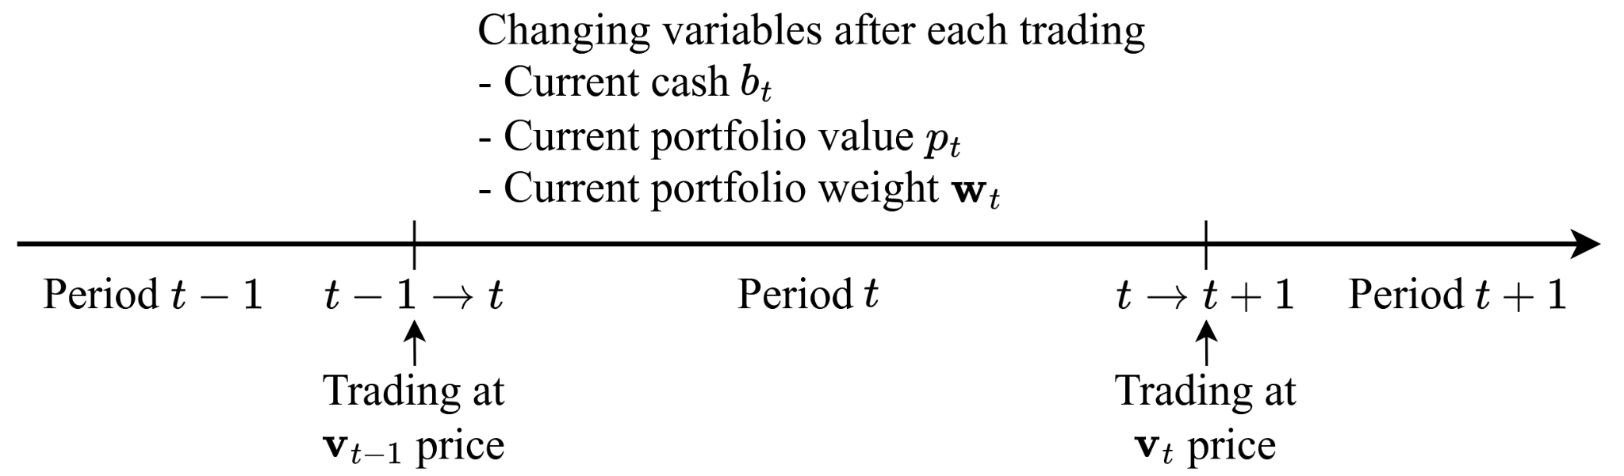
2. Background
Problem definition
m stocks
v_{t} ∈ R^{m}: Stock price vector
b₀: Initial cash
p₀=0: Initial portfolio value
w₀=0 ∈ R^{m}: Initial portfolio weight vector
Stock value Portfolio value
Weight = =
Stock price ✖ # Shares Portfolio value

Slide 26
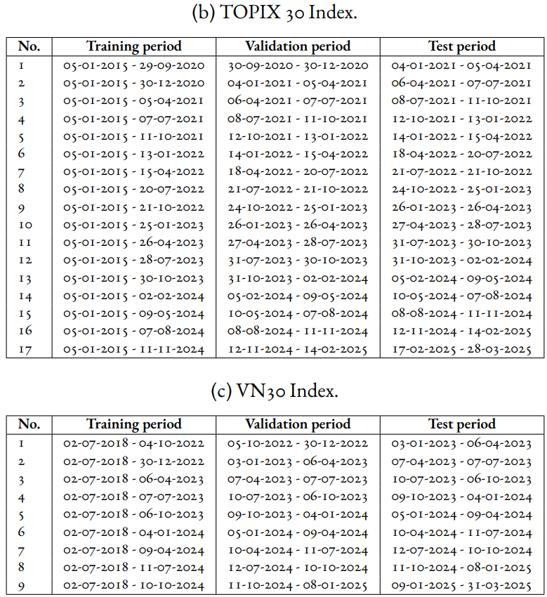
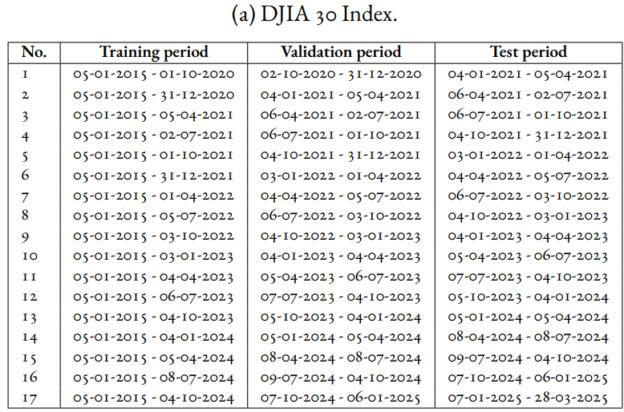
Appendix
Train/validation/test periods

Slide 27
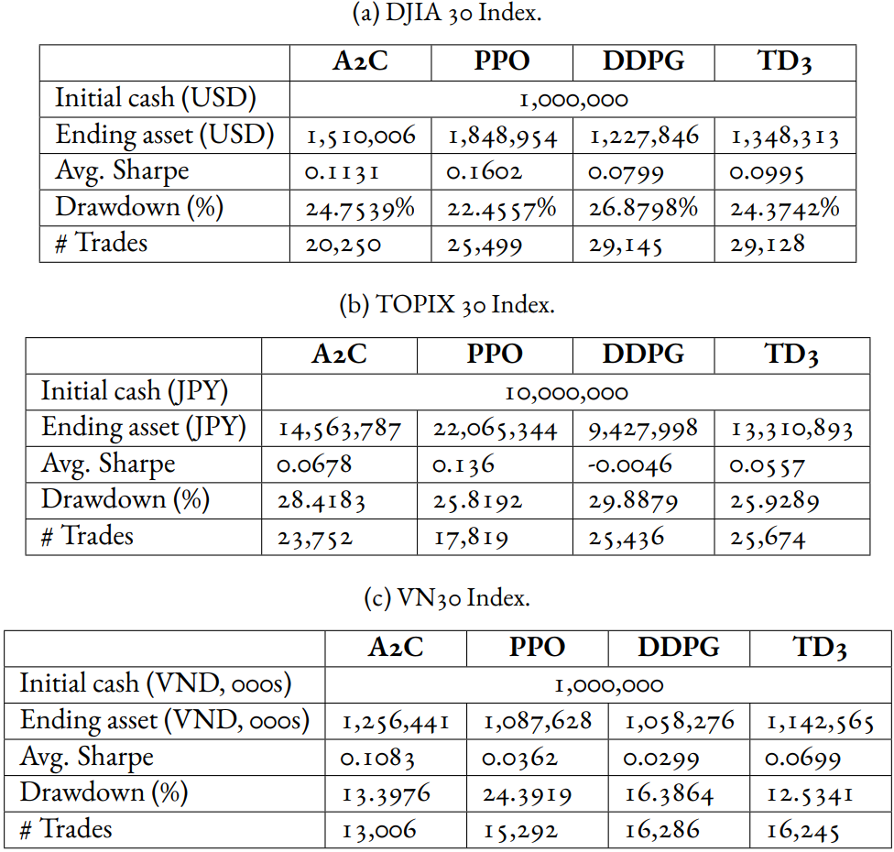
Appendix
Trading metrics
Off-policy models (DDPG, TD3) generated more trades than on-policy ones (A2C, PPO)
🇺🇸 US & 🇯🇵 JP PPO had highest ending asset & Sharpe ratio, and lowest drawdown
🇻🇳 VN A2C was the best model

